Slide 1
Extended Standard Library
Programming Lab Practical Computer Science
Nikhil Francis Giji: 12303308
Ardra Maria Prince: 22403661
Felix Augustine: 12401135

Slide 2
Introduction
The C++ Standard Library is a collection of classes and functions, including containers , algorithms , input/output facilities , and many utilities.
Containers: vector, map
Algorithm: sort, find
Input/Output : cin, cout
Helps programmers to develop robust and efficient applications.

Slide 3
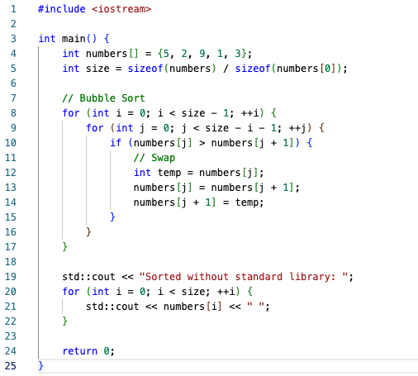
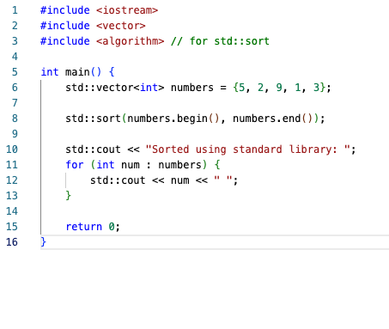
Comparison
Sort Function: Libraries Excluded
Sort Function: Libraries Included
Node
Node
Node
Node
Node
Node
Loss
Data
Target

Slide 4
Comparison Continue…
Feature | With Standard Library | Without Standard Library
Code simplicity | High (std::sort) | Lower (manual sorting)
Performance | Highly optimized | Depends on algorithm
Flexibility | Very flexible | Requires more code and knowledge
Linear
Node
Loss
Data
Target

Slide 5
Chrono
Part of the C++ Standard Library.
Used for dealing with time durations, clocks, and timestamps.
Measuring elapsed time (performance benchmarking)
Adding time delays.
Scheduling or timeout logic
Working with real-time clocks

Slide 6
Chrono Core Concepts
Duration: Represents a span of time (e.g., 5 seconds, 3 milliseconds)
Time Point: A point in time (e.g., system clock at this moment)
Clock: Provides the current time (system_clock, steady_clock, high_resolution_clock)
Common Clocks
Clock | Description
std::chrono::system_clock | Wall-clock time (can be converted to calendar time)
std::chrono::steady_clock | Monotonic time (good for measuring time intervals)
std::chrono::high_resolution_clock | Highest precision clock (alias to steady/system depending on platform)

Slide 7
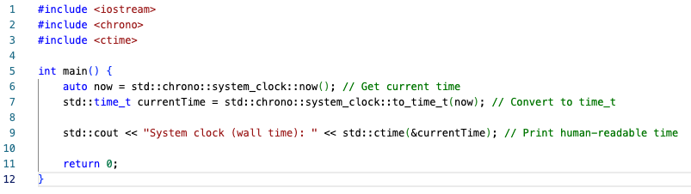
std::chrono::system_clock
Represents the current real-world (calendar) time.
Timestamping
Logging current date and time
Converting to std::time_t for printing
Code:
Output:

Slide 8
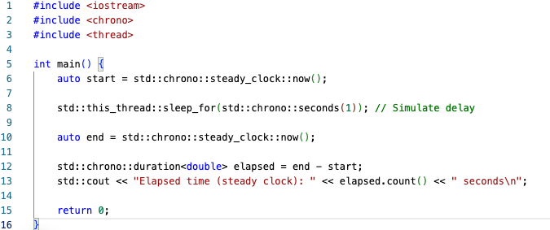
std::chrono::steady_clock
Time always moves forward, unaffected by system time changes.
Measuring durations reliably
Benchmarks or timeouts
Code:
Output:

Slide 9
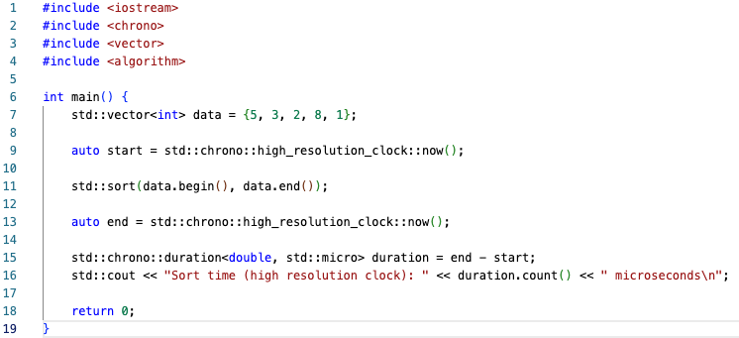
std::chrono::high_resolution_clock
Offers highest precision timing available (may alias to steady_clock or system_clock).
Fine-grained performance profiling
Microbenchmarking
Code:
Output:

Slide 10
Random
Provides modern tools for random and pseudo-random number generation.
Divided into two major components:
URBGs (Uniform Random Bit Generators)
Distributions (e.g. uniform, normal, Poisson)
Use Case | What You’d Use
Dice roll / random number | uniform_int_distribution
Random float | uniform_real_distribution
Simulating Gaussian data | normal_distribution
Shuffling | std::shuffle + random engine

Slide 11
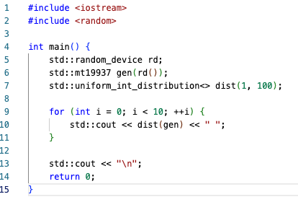
Uniform Random Bit Generators(URBGs)
Code:
Generate raw integer-based randomness
Examples:
std::mt19937 – Fast, widely used (Mersenne Twister)
std::random_device – True random (hardware-based if available)
Can be seeded, serialized, and reused
Output:

Slide 12
Random Number Distributions
Control the range and shape of generated numbers
Combine with URBGs to generate realistic data
Common distributions:
Distribution | Description
uniform_int_distribution<int> | Random integers in range
uniform_real_distribution<double> | Random floats
normal_distribution<double> | Bell-curve values

Slide 13
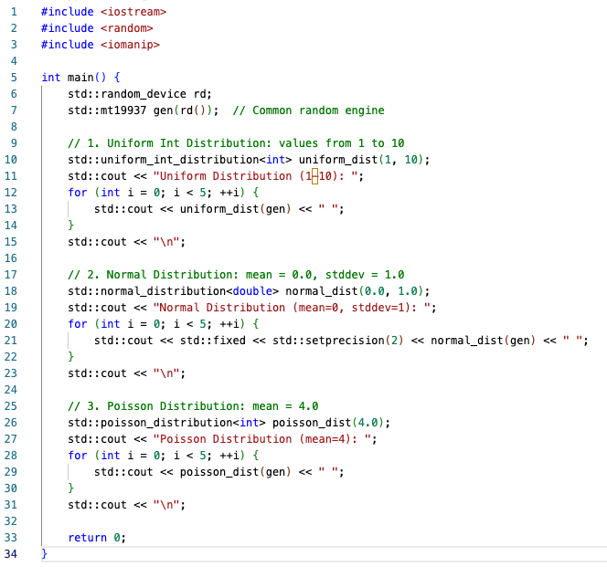
Random Number Distributions Code
Output:

Slide 14
Regex
Regular Expressions in C++
<regex> provides support for pattern matching using regular expressions
A regular expression is a mini-language for defining patterns in strings
Common in validation, search, and transformation tasks
Use Case | Example
Input validation | Check if email is valid
Text search | Find all dates in a document
Replacement | Replace multiple whitespaces with one
Parsing | Extract info from logs, URLs, commands

Slide 15
Regex Core Objects
Component | Description
Target sequence | The string to search (e.g., std::string, C-string)
Pattern | The regular expression, constructed as std::regex
Match result | Stores match info: std::smatch for strings
Replacement string | Used in regex_replace() to define new content

Slide 16
Regex Functions
Feature | Use
std::regex | Create a regex pattern
std::smatch | Store matches (for strings)
std::regex_match | True if whole string matches pattern
std::regex_search | True if any part matches
std::regex_replace | Replace all matched substrings

Slide 17
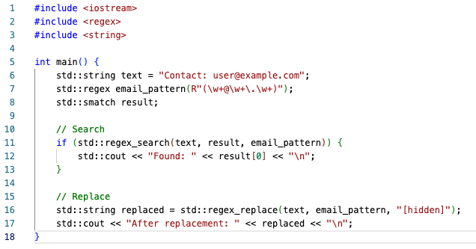

Regex Code
Output:

Slide 18
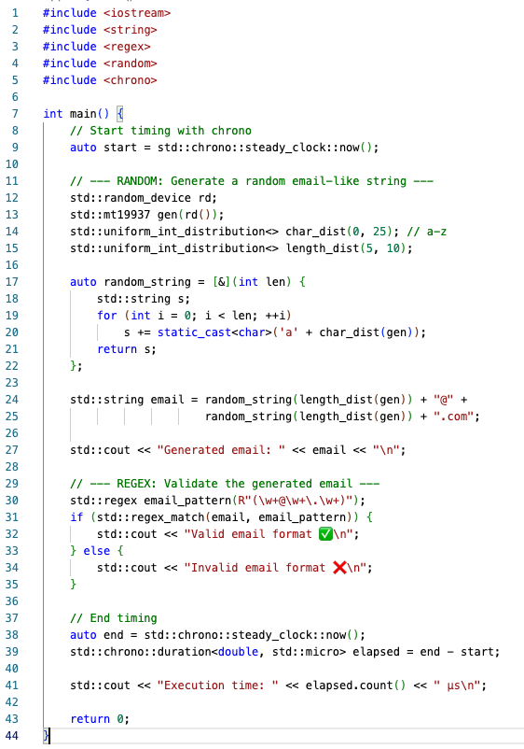

Code Example
Output:

Slide 19
Thank You

